Slide 1
Landau or Grand Potential
Also called Grand Free Energy
We know
Enthalpy $H=U+PV$
Helmholtz Free Energy $F=U−TS$
& Gibb’s Free Energy $G=U+PV−TS$
In all these cases, we kept, N fixed
How about the processes, where N changes?
P 5.23
We need to define a new thermodynamic: potential: Grand Free Energy
$$∅=U−TS−μN$$
OR $∅=F−μN$
We can also write
$$∅=U+PV−TS−μN−PV=G−μN−PV$$
But $G=μN$
Therefore $∅=−PV$
➔ $d∅=dU−TdS−SdT−μdN−Ndμ$
➔ $d∅=(TdS−PdV+μdN)−TdS−SdT−μdN−Ndμ$
➔ $d∅=−PdV−SdT−Ndμ$
$$∅(V,T,μ)$$
$${P=−\left(\frac{∂∅}{∂V}\right)}_{T, μ}$$
$${S=−\left(\frac{∂∅}{∂T}\right)}_{V, μ}$$
$${N=−\left(\frac{∂∅}{∂μ}\right)}_{V, T}$$
How about if we define another potential $ψ=U+PV−μN$ ?

Slide 2
Thermo-Diffusive Equilibrium
with a reservoir that provides energy and particles
$$dS_{Total}=dS+dS_{R}$$
----- (1)
Where S = Entropy of the system
S_{R} = Entropy of the reservoir
As $dU=TdS−PdV+μdN$
➔ $dS=\frac{dU}{T}+\frac{P}{T}dV−\frac{μ}{T}dN$
In thermal equilibrium,
$T=T_{R}$ & $dU=−dU_{R}$
Therefore, $dS_{R}=\frac{dU_{R}}{T_{R}}+\frac{P}{T_{R}}dV_{R}−\frac{μ}{T_{R}}dN_{R}$
In diffusive equilibrium,
$dN=−dN_{R}$ & $dV_{R}=0$
➔ $dS_{R}=−\frac{1}{T}dU+\frac{μ}{T}dN$
----- (2)
As V_{R} is fixed
$$dS_{Total}=dS−\frac{1}{T}dU+\frac{μ}{T}dN$$
Eq (1) and (2) ➔
$$=\frac{1}{T}\left[TdS−dU+μdN\right]$$
$$=−\frac{1}{T}\left[dU−TdS−μdN\right]$$
$$dS_{R}=−\frac{1}{T}dφ$$
We can say total entropy increases when Grand Free energy decreases for fixed V, T and $μ$

Slide 3
Summary of Important Thermodynamic Potentials and their natural variables
Name | Potential | Differential form
Internal Energy, | $$U\left(S, V, N\right) OR$$ $$S(U, V, N)$$ | $$dU=TdS−PdV+μdN$$ $$dS=\frac{1}{T}dU+\frac{P}{T}dV−\frac{μ}{T}dN$$
Enthalpy | $$H\left(S, P, N\right)$$ $$H=U+PV$$ | $$dH=TdS+VdP+μdN$$
Helmholtz Free Energy | $$F\left(T, V, N\right)$$ $$F=U−TS$$ | $$dF=−SdT−PdV+μdN$$
Gibb’s Free Energy | $$G\left(T, P, N\right)$$ $$G=F+PV=μN$$ | $$dG=−SdT+VdP+μdN$$
Grand Free Energy | $$φ\left(T, V, μ\right)$$ $$φ=F−μN=−PV$$ | $$dφ=−SdT−PdV−Ndμ$$
Also called Landau Potential, $Ω$

Slide 4
Remember we already have
Thermal expansion coefficient $β=\frac{1}{V}{\left(\frac{∂V}{∂T}\right)}_{P, N}$
Isothermal compressibility $κ_{T}=−\frac{1}{V}{\left(\frac{∂V}{∂P}\right)}_{T, N}$
Adiabatic compressibility $κ_{S}=−\frac{1}{V}{\left(\frac{∂V}{∂P}\right)}_{S, N}$
This will be help in your assignment

Slide 5
Phase Transformation of a pure Substance
Phase Transformation
A discontinuous change in the properties of a substance, as its environment does not change
Example:
ice → water → steam
These phase changes can be accomplished with only small change in temperature or pressure or both.
Phase diagram
A graph showing equilibrium phases as a function of temperature and pressure.
It has three regions:
Solid, Liquid and Gas phases
Some important points on Phase diagram
Triple Point
The point (T, P) where all three phases coexist in equilibrium.
Critical Point
The point on phase diagram where distinction between liquid and gas is impossible
Vapor Pressure
Pressure at which a gas can coexist with its solid or liquid phase
At low pressures, liquid cannot coexist with solid phase in equilibrium. Solid sublimates directly into gas

Slide 6
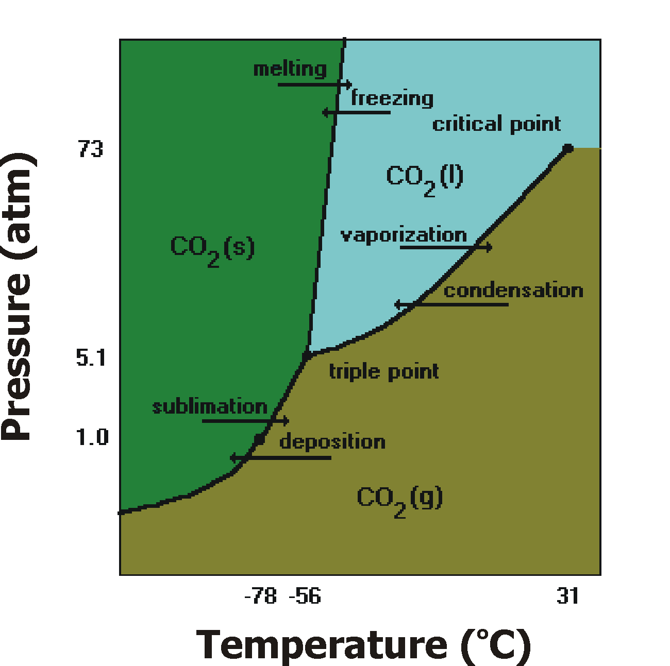
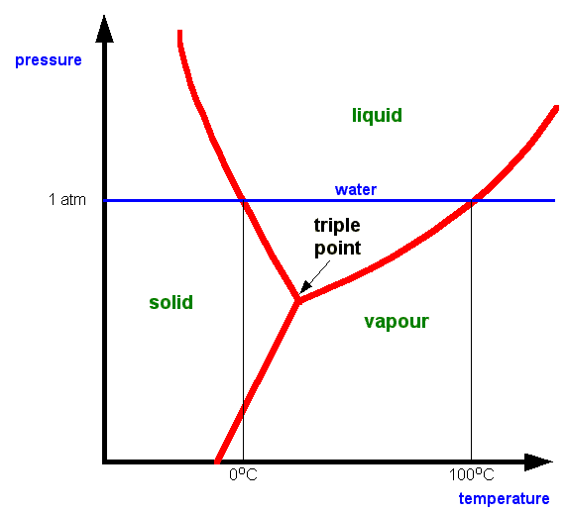
Water
CO₂
Critical point
Triple Point
for water (0.01 ºC, 0.006 bars)
Curves branching out from this point separate phase regions:
Fusion curve: solid-liquid boundary
Vaporization curve: liquid-gas boundary
Sublimation curve: solid-gas boundary
for CO₂ (-56.6 ºC, 5.2 bars)
Critical Point
for water (374 ºC, 221 bars)
for CO₂ (31 ºC, 73.8 bars)

Slide 7
Difference between H₂O and CO₂
For CO₂ (usual), P increases, melting T increases – The slope of solid-liquid phase boundary is positive
But water is special, melting T decreases with P – the slope of solid-liquid phase boundary is negative.
Ice is less dense than water
Some materials, especially polymers, can for “Liquid Crystal” phase where molecules move around randomly as a liquid but keep their orientations parallel to each other
The only element that remains liquid at 0 K at atm pressure
A very special phase diagram is of Helium
Helium has two isotopes He⁴ and He³
He⁴ becomes super fluid below about 2.2 K and less than ~ 25 bars.
He³ has two super fluid phases below 3 mK and below35 bars.
A super fluid has zero viscosity and very high thermal conductivity

Slide 8
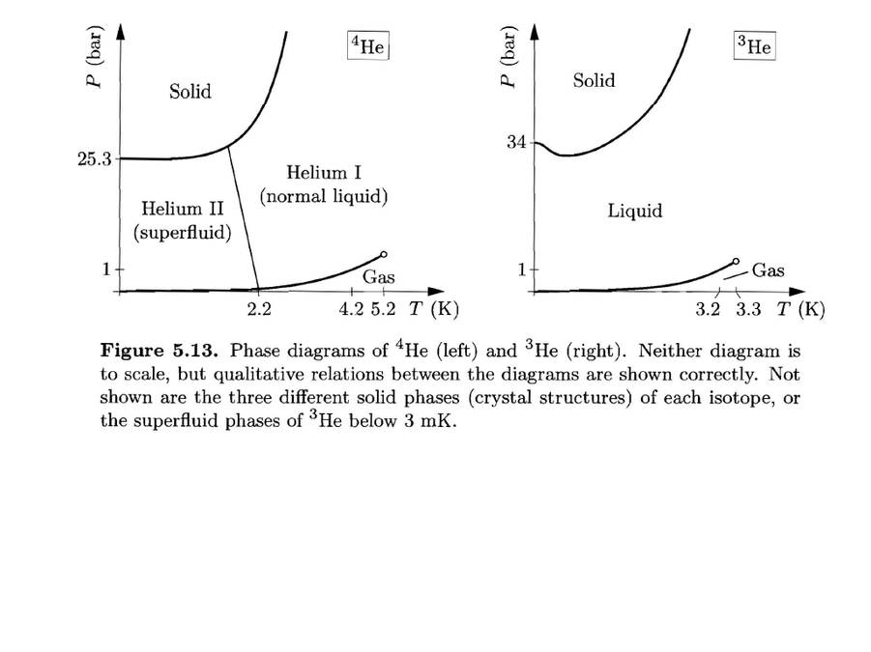
Critical point
Critical point
0.3 K
He⁴
He³
It has 2 super fluid phases, both below 3 mK
It becomes solid at P > 30 bars
Solid-liquid phase boundary has negative slope below 0.3 K
Boiling Temp at atm pressure 3.2 K
Critical point (3.3 K, 2 bars)
Becomes solid at 2.5 bars and T< 2.2 K
Solid-liquid phase boundary is almost horizontal
Boiling Temp at atm pressure is 4.2 K
Critical point is (5.2 K, 2.3 bars)

Slide 9
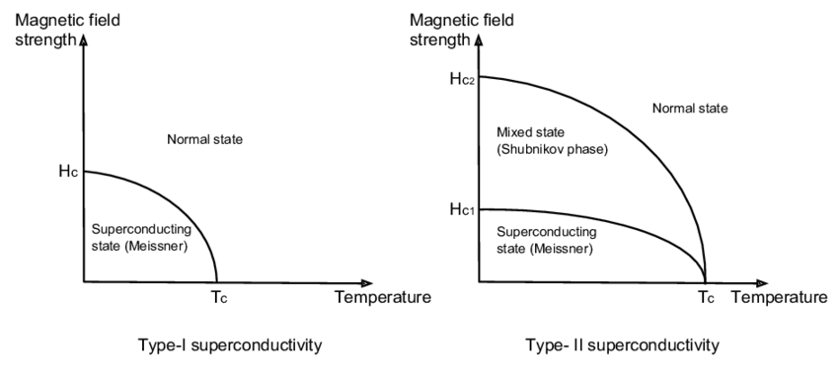
Temperature and Pressure are not the only variable that can cause phase change
Example?
Magnetic field strength can also cause the phase change
For Lead,
H_{C} = 0.08 Tesla
and
T_{C} = 7.2 K
Ferromagnets
B ($μ_{0}H$)
Magnetization up
T_{C}
Magnetization disappears after critical temp, T_{C} called Curie Temperature
0
T
For iron T_{C} ~ 1043 K
Magnetization down

Slide 10
Diamond & Graphite
Both are solid phases of Carbon, but their crystal structure is different
At ordinary pressure, the stable phase is Graphite
Do not throw your diamond in fire
Diamond will spontaneously become graphite at high temperature and/or extremely low pressure
Gibb’s Free Energy, G determines which phase is stable under P & T conditions
At atm Pressure & room temperature, the value of G for 1 mole of
Diamond (= 2900 J) > Graphite
➔ Graphite is stable
$${V=\left(\frac{∂G}{∂P}\right)}_{T, N}$$
We know, $G(T, P, N)$ and
Graphite
At room Temp
➔
1 mole of Graphite has greater Volume as compared with diamond
G (kJ/mol)
Diamond
Note: At high Pressure (and low T), Diamond has low G ➔ stable phase
2.9 kJ
Slope = ${\left(\frac{∂G}{∂P}\right)}_{T, N}=V$
1
5
10
15
P (kbars)

Slide 11
Graphite
Slope = $V$
At room Temp
$$V_{graph}=5.3×{10}^{−6} m^{3}$$
G (kJ/mol)
Diamond
$$V_{Diamond}=3.42×{10}^{−6} m^{3}$$
At room T
2.9 kJ
and Pressure < 15 kbars
Graphite phase is more stable
Diamond phase is more stable
1
5
10
15
P (kbars)
As you go deeper underground, P increases ~ 3 bars per 10 m
To reach 15 kbar, you need to go more than 50 km deep underground
On the other hand,
Therefore, natural Diamond is formed at greater depth
$${S=−\left(\frac{∂G}{∂T}\right)}_{P, N}$$
But G decreases with T more rapidly for graphite
(b/c Graphite has larger Entropy)
➔ As T increases, G decreases
Conclusion:
Diamond phase is stable at high P and low T
Graphite phase is more stable at higher T

Slide 12
Useful for Geo-Chemistry
Gibb’s Free Energy is the key to understand phase transformation
In Geo-Chemistry units of Volume
$$\frac{kJ}{kbars}$$
$$=\frac{J}{bars}=\frac{N∙m}{{10}^{5}\frac{N}{m^{2}}}$$
Problem 5.25
$$={10}^{−5} m^{3}$$
$$=10 {cm}^{3}$$

Slide 13
The Clausius-Clapeyron Relation
We know
$${S=−\left(\frac{∂G}{∂T}\right)}_{P, N}$$
$${V=\left(\frac{∂G}{∂P}\right)}_{T, N}$$
$${μ=\left(\frac{∂G}{∂N}\right)}_{T, P}$$
S determines T dependance of G
V determines P dependance of G
In Phase diagram (P vs T)
The shape of phase boundary line is related to Entropy, S and Volume, V
At phase boundary, two phases are equally stable
At Liquid and Gas phase boundary
$$G_{l}=G_{g}$$
➔$dG_{l}={dG}_{g}$
Since $G(T, P, N)$
For constant N
➔ ${dG=\left(\frac{∂G}{∂T}\right)}_{P, N}dT+{\left(\frac{∂G}{∂P}\right)}_{T, N}dP$
$$=−SdT+VdP$$
Therefore,
$$−S_{l}dT+V_{l}dP=−S_{g}dT+V_{g}dP$$
$$S_{g}dT−S_{l}dT=V_{g}dP−V_{l}dP$$
➔ $(S_{g}−S_{l})dT={(V}_{g}−V_{l})dP$

Slide 14
As $(S_{g}−S_{l})dT={(V}_{g}−V_{l})dP$
$\frac{ΔS}{ΔV}=\frac{dP}{dT}$
At the boundary of phase transformation
Therefore, the slope of phase boundary line is determined by Entropy and Volume of the phase
Since $S=\frac{δQ}{T}$
Larger the entropy difference, smaller the temperature change is need to change the phase
And at phase change $δQ=mL$
Where L is Latent heat
Let’s assume m =1 (arbitrary units)
➔ $S=\frac{L}{T}$
Therefore,
$\frac{ΔS}{ΔV}=\frac{dP}{dT}$
$$\frac{dP}{dT}=\frac{L}{TΔV}$$
Clausius-Clapeyron Relation
$\frac{dP}{dT}$ is the slope of any phase boundary: gas-liquid or solid-liquid

Slide 15
Van der Waals Model
To understand phase transformation more deeply we need to consider interactions between particles
For Liquid Gas phase transformation, the most famous model is
Van der Waals Model
Ideal gas
$$PV=NK_{B}T$$
--- Ideal gas equation of state
$$\left(P+\frac{aN^{2}}{V^{2}}\right)\left(V−Nb\right)=NK_{B}T$$
Van der Waal equation of state
Van der Waals model
Attractive forces
Repulsive forces
Short range attractive force
➔ increased effective pressure
Short range repulsive forces
➔ decreased effective volume
As for as particles in neighborhood but not touching each other
The forces turned repulsive when particle start overlapping each other

Slide 16
$$P+\frac{aN^{2}}{V^{2}}$$
Effective pressure due to attractive forces
Effective volume due to repulsive forces
$$V−Nb$$
Since Fluid can not be compressed all the way to zero
The minimum volume = Nb
➔ The constant b = volume occupied by one particle
The Van der Waal’s equation of state is
$$\left(P+\frac{aN^{2}}{V^{2}}\right)\left(V−Nb\right)=NK_{B}T$$
---------- (1)
➔ $P=\frac{NK_{B}T}{(V−Nb)}−\frac{aN^{2}}{V^{2}}$
---------- (2)
We know that at a given T and P, the true equilibrium state of a system is determined by Gibb’s Free Energy
$$dG=−SdT+VdP+μdN$$
And for fixed values of T & N
➔ $dG=VdP$
OR ${\left(\frac{∂G}{∂V}\right)}_{T, N}=V{\left(\frac{∂P}{∂V}\right)}_{T, N}$
---------- (3)

Slide 17
Now from Eq (2), we can get
$${\left(\frac{∂P}{∂V}\right)}_{T, N}={\left[\frac{∂}{∂V}\left(\frac{NK_{B}T}{(V−Nb)}−\frac{aN^{2}}{V^{2}}\right)\right]}_{T, N}$$
$$=\left[\frac{−NK_{B}T}{{\left(V−Nb\right)}^{2}}+\frac{2aN^{2}}{V^{3}}\right]$$
Plugging back to Eq (3)
${\left(\frac{∂G}{∂V}\right)}_{T, N}=V{\left(\frac{∂P}{∂V}\right)}_{T, N}=$ $\frac{−NK_{B}TV}{{\left(V−Nb\right)}^{2}}+\frac{2aN^{2}}{V^{2}}$
${\left(\frac{∂G}{∂V}\right)}_{T, N}=$ $\frac{−NK_{B}TV}{{\left(V−Nb\right)}^{2}}+\frac{2aN^{2}}{V^{2}}$
Constant of integration that depends on T
$$G=−NK_{B}Tln\left(V−Nb\right)+\frac{\left(NK_{B}T\right)\left(Nb\right)}{V−Nb}−\frac{2aN^{2}}{V}+C(T)$$
This equation allows to plot Gibb’s Free Energy for any given T vs V
But more important is plot of G vs P
But you need to calculate P for each V using Eq (2)

Slide 18
PV diagram of ideal gas and for Van der Waals gas
Note:
For $T>T_{C}$ isotherms of Van der Waals gas are similar to those of Ideal gas

Slide 19
Assignment # 7 Due 4/1/2022
5.2, 5.5, 5.14, 5.16 & 5.22
Problems for practice of Ch 5:
5.1, 5.8, 5.10, 5.20, 5.23, 5.24, 5.25, 5.28, 5.32 (a, b), 5.35 and 5.47
Exam#2 covering Ch 4 & 5
Wed 4/6/2022

